Slide 1
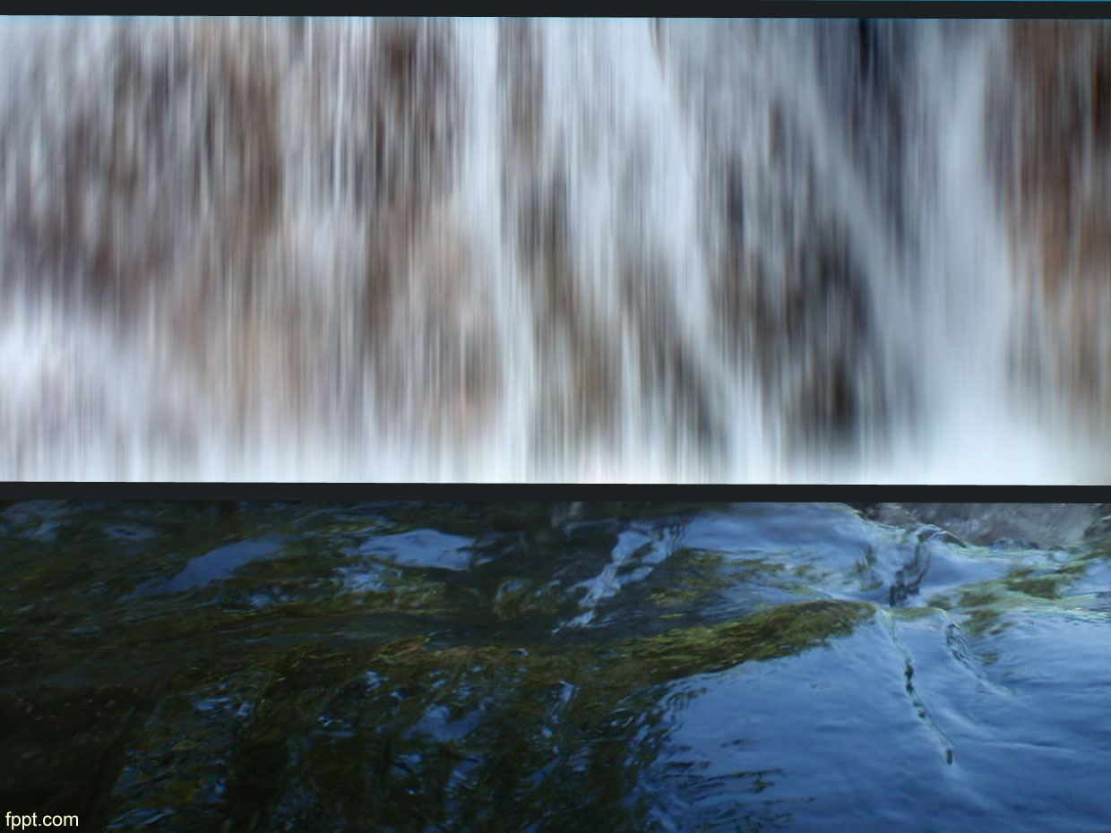
Water management in the area of Phocis prefecture and Parnassos National Park
Summer School on Education for Sustainable Development in Protected Areas and Biosphere reserves in Amfissa, Phocis prefecture, Greece, from 6th to 19th of July 2014.
Ali Meydan
Marco Dubbini
Mikhail Yablokov
Nikola Panduric
Savvas Vasileiadis

Slide 3
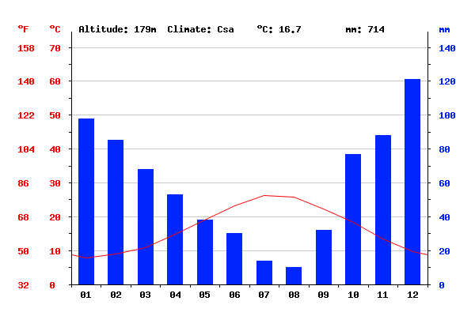
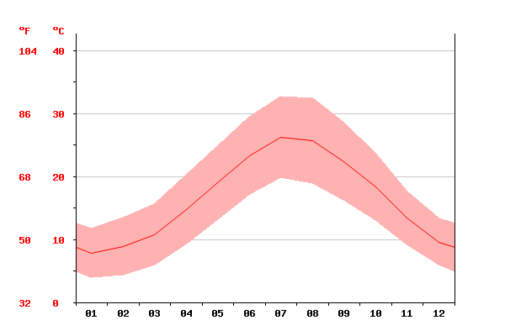
Results (1) / GEOGRAPHY, GEOLOGY, HYDROGEOLOGY AND CLİMATE
Amfissa Climate
Greece is the most earthquake-prone country in Europe
The Itea - Amfissa valley divides the Mount Giona to the west from the Mount Parnassos to the east.
Groundwater and the fractured carbonate rocks through which it moves constitute a dynamic system in which both the fluid and the container are actively reacting and changing in time and space
Karst Hydrogeology at Amfissa and Around
Why are karst aquifers important?
Amfissa Climate

Slide 4

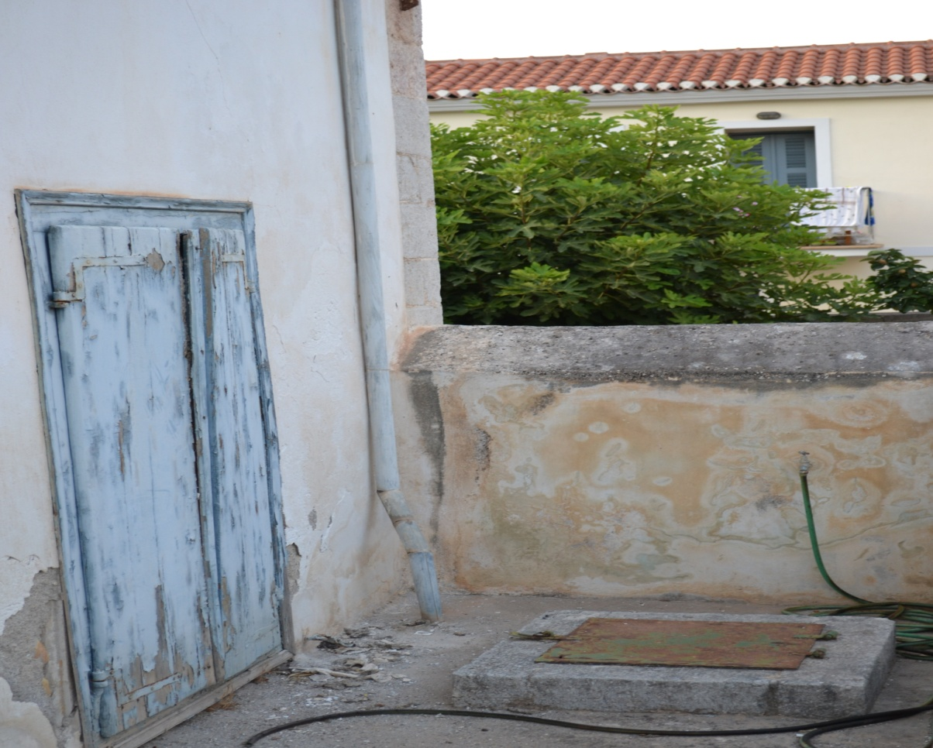
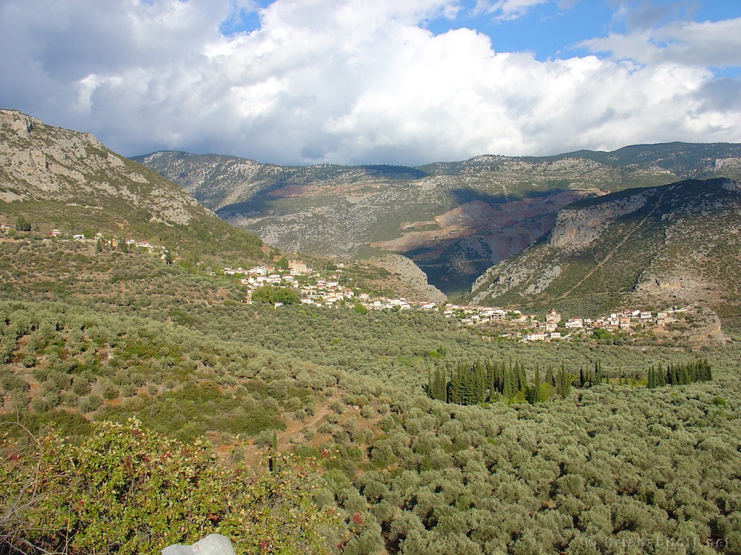
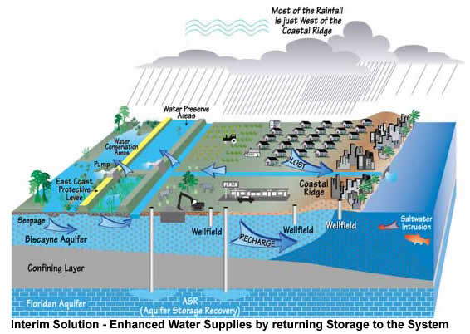
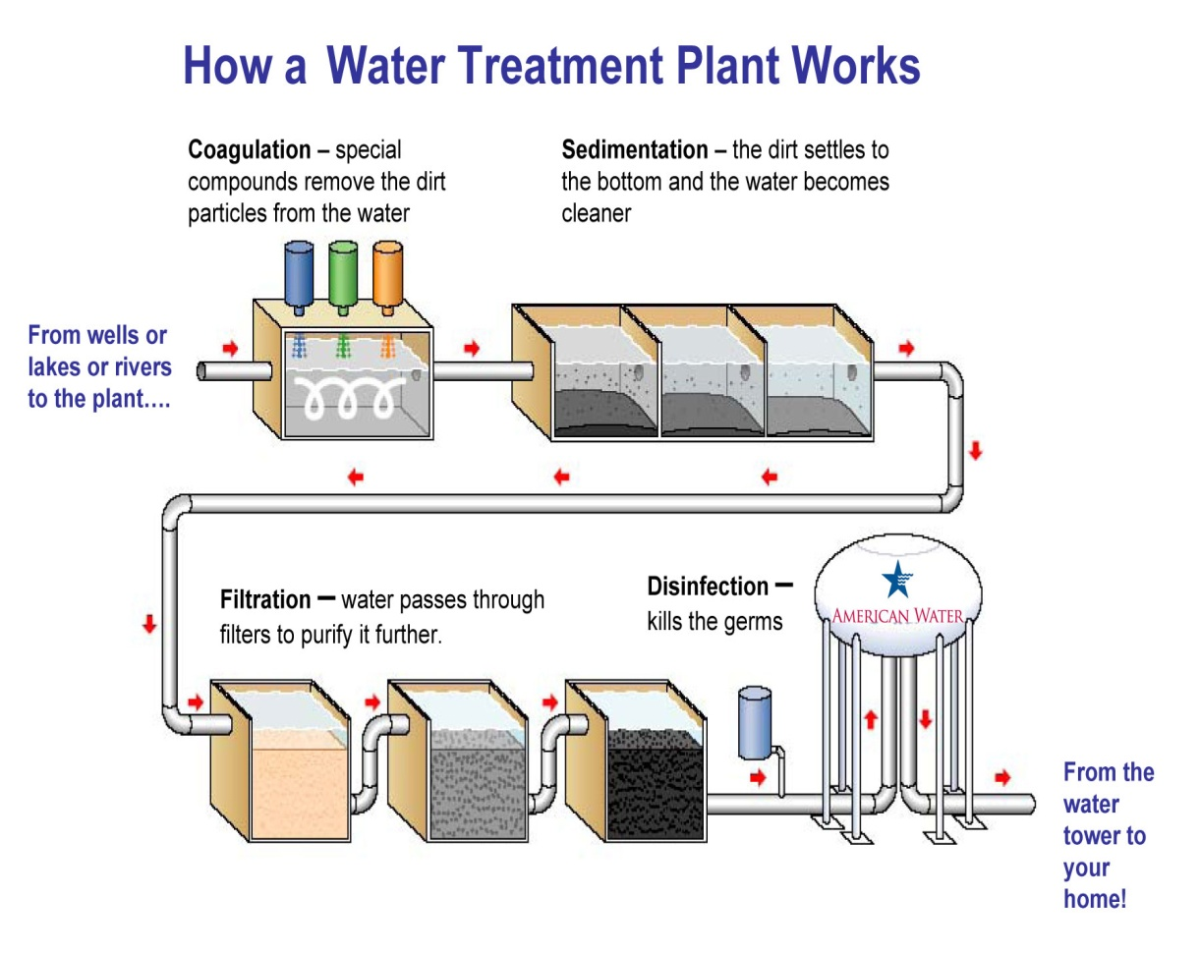
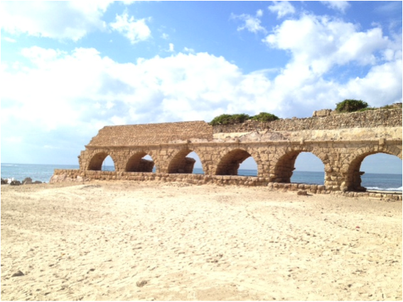
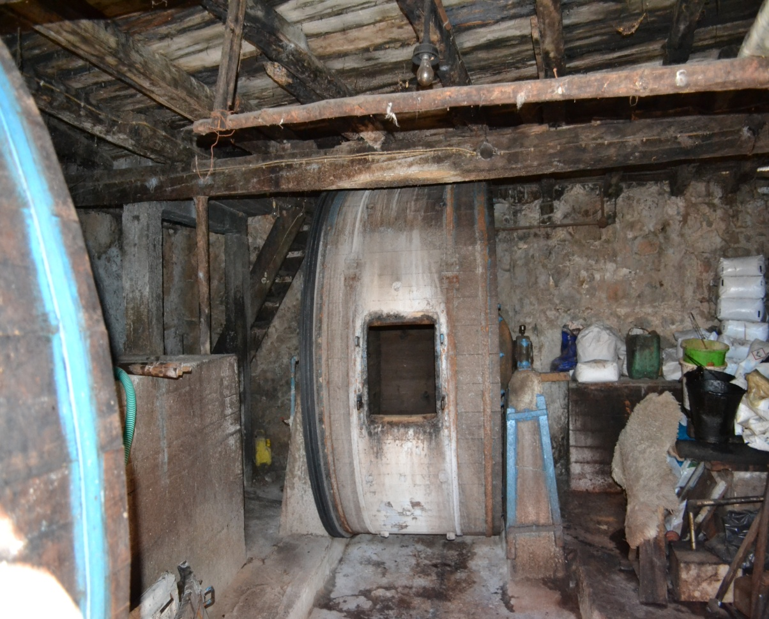
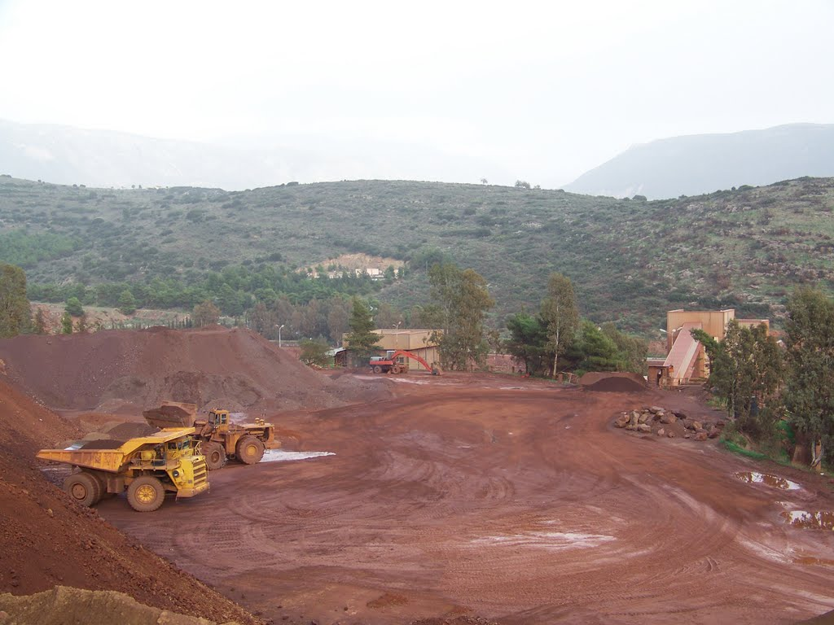
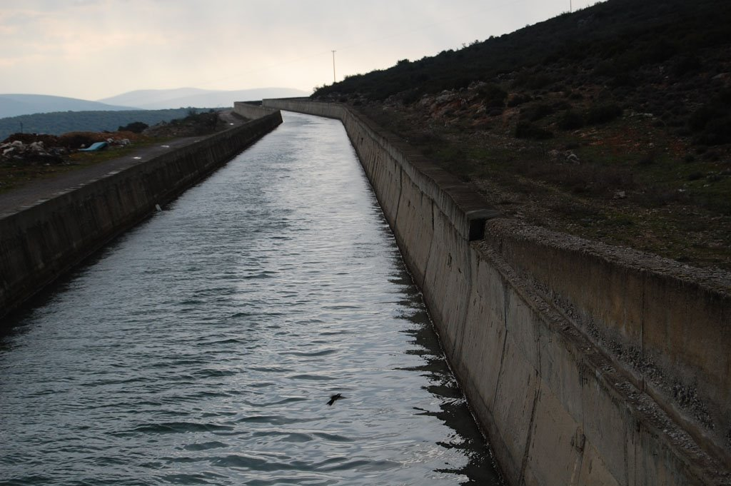
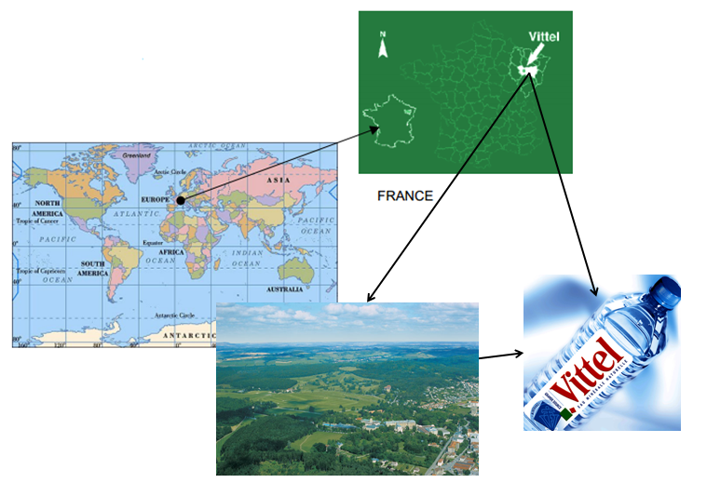
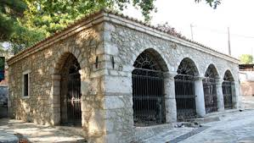
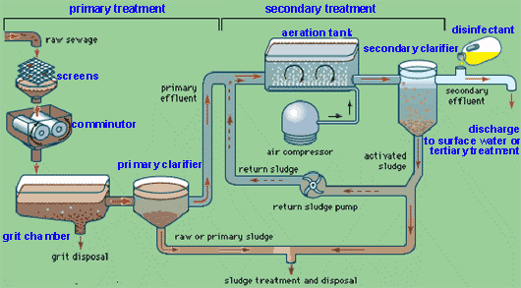
Results (2) / PAST AND PRESENT WATER MANAGMENT
WATER MANAGEMENT IN THE PAST
  LEATHER PRODUCTION
  WATER CISTERNS
  OLIVE OIL TREES IRRIGATION
WATER MANAGEMENT PRESENT
  POTABLE WATER
    EXAMPLE
  SEWAGE WATER TREATMENT
  TOURISM
  BOKSIT MINES
  LOCAL ESD

Slide 5
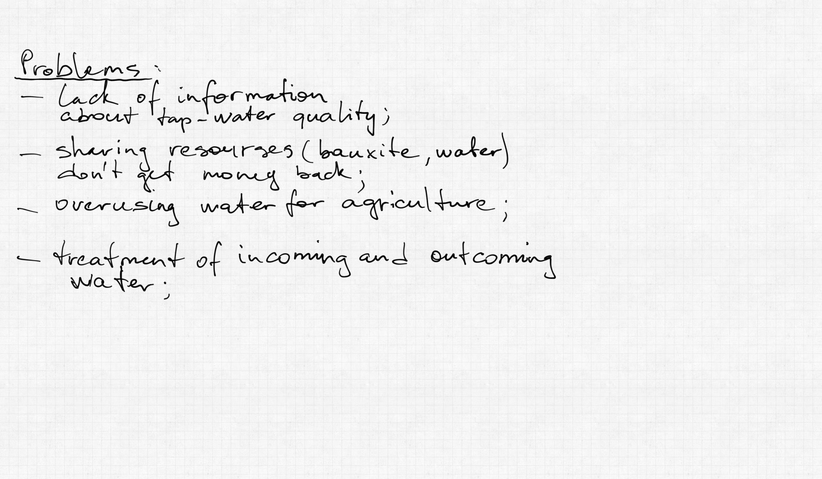
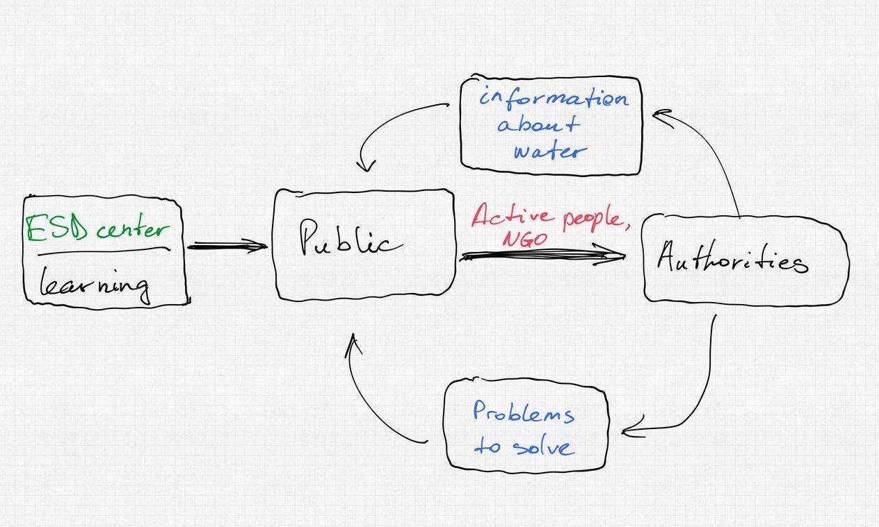
CONCLUSIONS AND RECOMMENDATIONS

Slide 6
Thank you!

